Slide 1
Semiquanduqtol Semi - QUantum Algorithm for Neuromorphic Design Using QuanTum Optimization and Learning
Team Qbrain
김자은 Jaeun Kim (Presenter)
박경근 Kyoung Keun Park
이경민 Kyoungmien Lee
이정훈 Jeonghoon Lee

Slide 2
Content
Introduction
Main
Result
Motivation
Project Goal
Part 1. Hybrid QUantum SNN
Part 2.a Graph Clustering
Part 2.b Hardware mapping
Simulation result
Conclusion
Future work

Slide 3
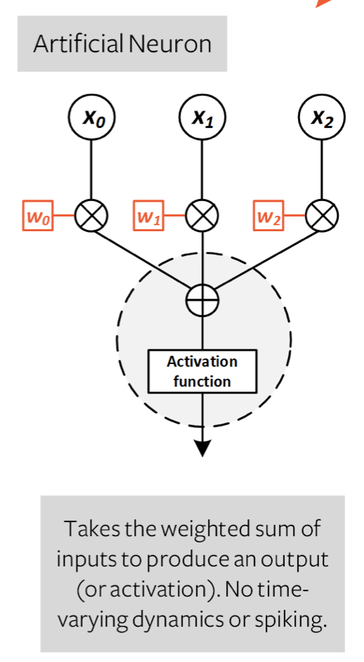
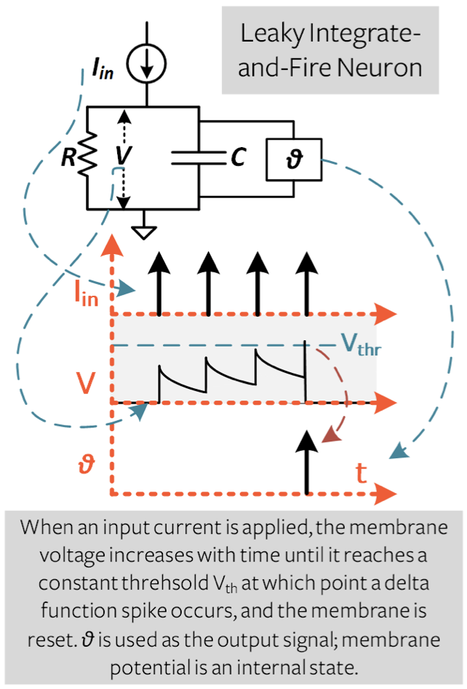
Motivation
Those pictures are from https://snntorch.readthedocs.io/en/latest/tutorials/tutorial_2.html
Artificial Intelligence has been very successful in the fields such as computer vision.
Its success relies on the idea of imitating neurons, a powerful computing mechanism.
Can we make neural networks even more powerful by building models that have a better resemblance to neurons?
Spiking Neural Network (SNN) is a novel approach to building neural networks. It closely resembles how our brain cells work.
While conventional neural networks represent data in matrices of numbers, SNN represents data in a time sequence of pulses.
It is anticipated to be more energy-efficient than conventional neural networks.
References: (we recommend reading the “Introduction” paragraph on this page) https://snntorch.readthedocs.io/en/latest/
Conventional neural networks
SNN

Slide 4
Project Goal
End to end Neuromorphic (AI semiconductor) designing using quantum Optimization algorithm and hybrid quantum machine learning
•Part 1 : Training Hybird Quantum Spiking Neural Network
•Part 2 : Mapping SNN to Neuromorphic Hardware
•Part 2a : Cluster SNN to smaller graph
•Part 2b : Map Cluster to Neromrophic Crossbar

Slide 5
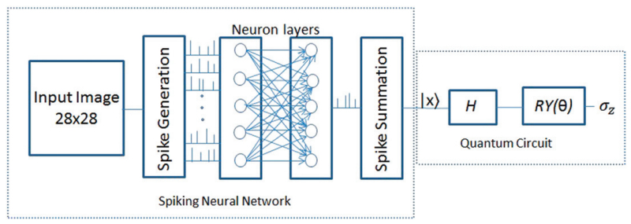
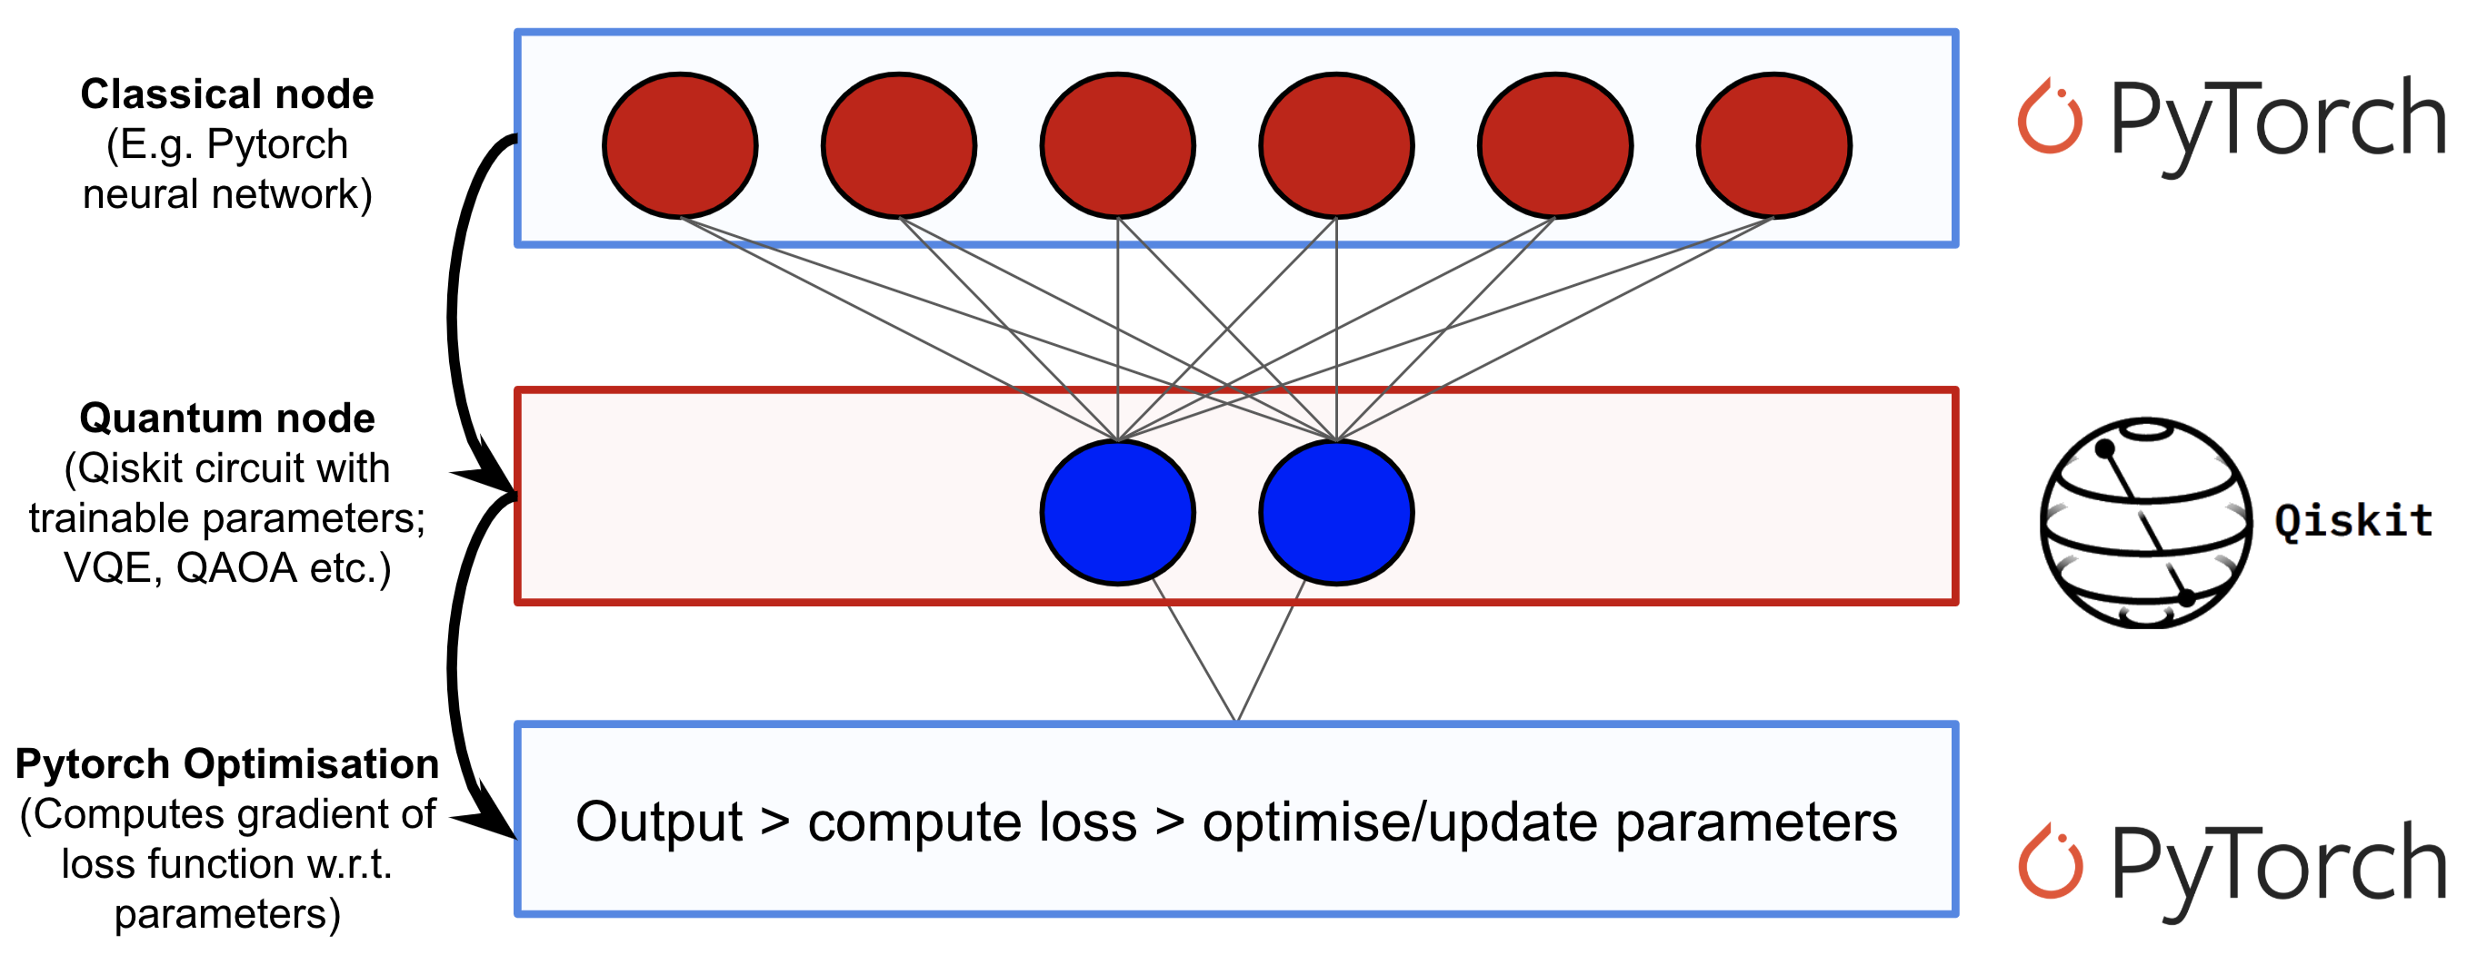
Part 1 [Ref #1]
Training Hybird Quantum Spiking Neural Network
The overall structure basically follows the qiskit's Hybrid QCNN network (https://qiskit.org/textbook/ch-machine-learning/machine-learning-qiskit-pytorch.html) & the structure proposed in the reference [2] (They are very similar)
The main difference is actually the classical model part (CNN vs SNN)
SNN samples data from image (Data with time information)
We feed-forwards the spike data to SNN
The output of SNN is also spike data ➔ (T, 2) tensor where T is the number of time steps
We sum up these spike data ((T,2) -> (1,2) by summing up)
Use the output as a single qubit rotation angle (Ry)
Use Z expectation value to classify MNIST digits
Data : MNIST with 2 classes(3 & 6)
We want to properly train this QSNN network & Plan to use IBM’s real quantum device with QEC(e.g. CSS code)
Possible advantage of QSNN : SNN also has probabilistic nature (Sampled data / Can treat sequence data ➔ Can generate sequence like RNN / …). Therefore, we expect that there combination is somewhat natural and quantum computer will handle such property of SNN well.

Slide 6
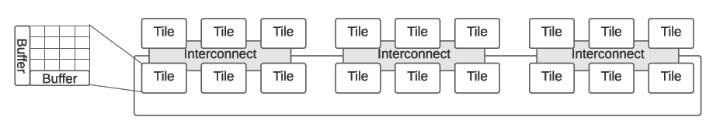
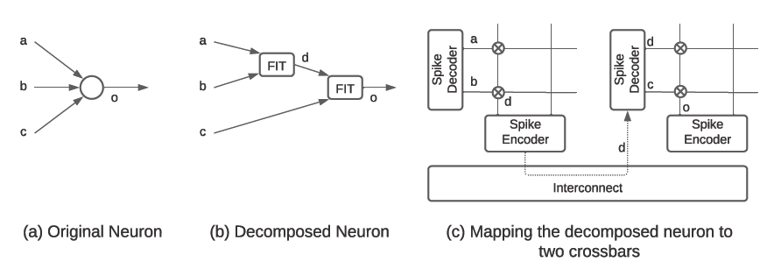
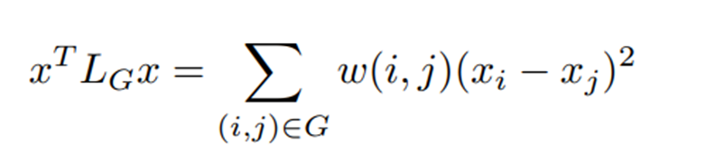
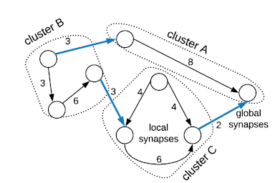
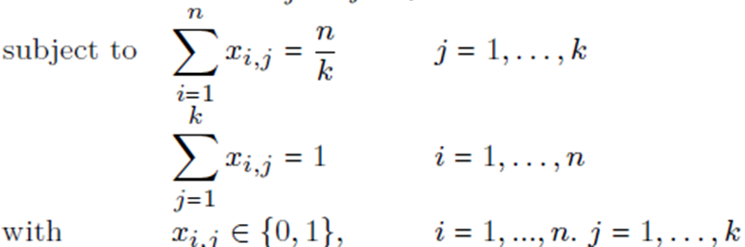
Part 2a [Ref #2]
Figure 1
Cluster Spiking Neural Network graph to smaller graphs
- Cross bar based neromorphic is consist of crossbar and interconnect like upper figure 1
- Crossbar based neromrophic has limited amount of hardware, full SNN graph have to be divided(clustered) to several small graph like figure 2(a) to (b) which works like (c)
- Problem is divide graph to smaller graph like figure 3
Problem formulation
objective
Optimization Method : Quantum Approximate Optimization Algorithm (QAOA)
- Express constraint binary quadratic optimization problem to quadratic unconstraint binary optimization
- Use Qiskit to express QAOA circuit
- Find Optimize value using that circuit
Figure 2
Figure 3

Slide 7
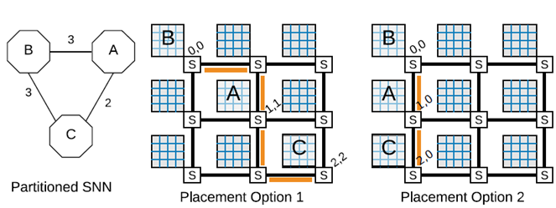



Part 2b [Ref #2]
Map Cluster to Crossbar based Neuromorphic hardware
- minimize spike congestion on shared interconnected
- to minimize energy consumption and spike latency
Problem formulation
Objective : minimize (total spike #) x (Spike moving distance)
Subject to
Optimization Method : Durr –Hoyer algorithm [ref #3]
- Build quantum circuit that can execute Durr Hoyer using Qiskit
- Build oracle that can express unconstraint objective function
- Build Grover algorithm in Qiskit
Better

Slide 8
Result and Conclusion
Simulation Result
- show Hybrid Quantum SNN can propose classification of MNIST
- show Quantum optimization algorithm can design neuromorphic of given SNN
Conclusion
- Quantum algorithm can design neuromorphic

Slide 9
Future work
In this Project : Topic is to design Classical Neuromorphic helped by quantum
Future : Quantum Neuromorphic
- Hybrid quantum network -> Fully quantum network
- Quantum Scale graph mapping using quantum algorithm

Slide 10
References
[1] A Ajayan and A P James, "Edge to quantum : hybrid quantum-spiking neural network image classifier"
[2] Adarsha Balaji et al, "Mapping Spiking Neural Networks to Neuromorphic Hardware"
[3] Christoph Durr and Peter Hoyer, "A quantum algorithm for finding the minimum"

Slide 11
Thank You

